Slide 1

Ramrao Adik Institute of Technology
Department of Computer Engineering
SE Mini Project-I
Topic Selection Presentation By
Roll No. NAME OF THE STUDENT.
21CE1177 Akshat Tiwari
21CE1165 Aditi Pandey
21CE1160 Lavanya Talele
21CE1133 Sweta Gupta
Name of Division Coordinator
(Mini Project SE-div Coordinator)

Slide 2
Topic 1: Title
Introduction
Idea of Implementation
Scope of the Project
References

Slide 3
Topic 1: Title

Slide 4
Topic 2: Title
Introduction
Idea of Implementation
Scope of the Project
References

Slide 5
Topic 2: Title MOVIE FINDER
INTRODUCTION
Entertainment is no longer just anything that we enjoy occasionally, with over two million spectators a day, the amount generated by the movie industry is huge. The movie sector is one of the biggest contributors to the entertainment industry’s unpredictability in success and failure. The aim of this research work to design an efficient movie recommendation algorithm that will increase prediction accuracy, the Movie Review Rating Prediction was achieved through a systematic review of the existing movie success algorithm. This research work will enable movie stakeholders (producers, directors, crew, cast already in the movie industry or aspirants) to know the kind of movie to invest in which will, in turn, be beneficial in terms of higher profit.

Slide 6
IDEA OF IMPLEMENTATION
Everyone loves movies irrespective of age, gender, race, color, or geographical location. We all in a way are connected to each other via this amazing medium. Yet what most interesting is the fact that how unique our choices and combinations are in terms of movie preferences. Some people like genre-specific movies be it a thriller, romance, or sci-fi, while others focus on lead actors and directors. When we take all that into account, it’s astoundingly difficult to generalize a movie and say that everyone would like it. But with all that said, it is still seen that similar movies are liked by a specific part of the society.

Slide 7
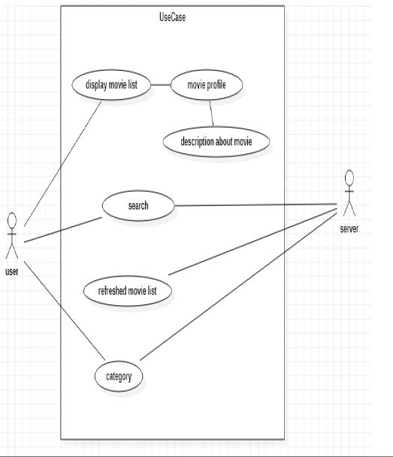
Work on several numbers of data:The number of choices for anything on internet is very high and it’s tedious to refine most wanted data by self while searching. The scope of this proposal system includes working within numerous data, with ease.Saving of time:Many people have problem selecting the alternative item of movie due to lack of time and due to search issues. Also movie recommendations from friends can be time consuming. The system helps in saving lots of time.

Slide 8
SCOPE FOR PROJECT:
The scope of the application is that it provides the user the information about the movie. It also gives information about the rating, year of release along with proving them the similar movies to the searched movie. It gives user to view the currently playing trailer along with the top rated movies, popular movies and upcoming movies.
Discuss the film plot briefly. Share some information about characters, relations and events, but don’t tell the whole story. Reading the review shouldn’t replace watching the film. Yet, you are free to mention the most important moments or turning points that make the film worth watching.

Slide 9
Analyze the film in general and in certain aspects, such as the acting, the work of the director, theme, music, and special effects. Make a conclusion if the main idea of the film was duly implemented. Try to be objective and detailed in your evaluations.Share your opinion. Describe your feelings during, and after watching the movie and specify what you liked, and what you didn’t like. Provide your general impression about the film based on examples, descriptions, and comparisons to enable readers to make their own decisions.
Give a recommendation. Try not to be categorical, but let your readers know what they can expect from the film, and who might find it interesting. Say if it matches an official film description and declared genre, why it might be worth watching, and what its weaknesses are.Entertain the reader. Reading movie reviews is actually kind of fun in itself. We’ve, as a society, gotten used to using this option before choosing a film to watch. Try to make an easy-to-read review, and write in an interesting manner.

Slide 10
REFERENCES:
Antara, U., Nivedita, K., Shalin, S., Tanisha, M., & Pranali, W. (2018). Movie Success Prediction Using Data Mining. International Journal of Engineering Development and Research, 6(4), 198–203.
Bhave, A., Kulkarni, H., Biramane, V., & Kosamkar, P. (2015). Role of different factors in predicting movie success. 2015 International Conference on Pervasive Computing: Advance Communication Technology and Application for Society, ICPC 2015. https://doi.org/10.1109/PERVASIVE.2015.7087152
Dhir, R., & Raj, A. (2018). Movie Success Prediction using Machine Learning Algorithms and their Comparison. ICSCCC 2018 - 1st International Conference on Secure Cyber Computing and Communications, 385–390. https://doi.org/10.1109/ICSCCC.2018.8703320
Gaikar, D., Solanki, R., Shinde, H., Phapale, P., & Pandey, I. (2019). Movie Success Prediction Using Popularity Factor from Social Media. International Research Journal of Engineering and Technology, 6(4), 5185–5190.

Slide 11
TOPIC 3: Recipe Finder
Introduction
After a long day of work, or a hectic schedule people want to come home eat food and relax. Surely takeouts are easy and delicious but home- cooked meal has its own flavor and satisfaction. To find a proper source of learning to cook for a beginner is difficult. That’s why we have come up with the idea of Recipe Finder app which provides users with step-by-step recipes to make the task of preparing a meal less hectic.

Slide 12
Idea of Implementation
Recipe Finder application is a very useful for people who love to cook and try out new recipes. Recipe Finder provides user flexibility to search, share, save recipes from cloud with an additional capability to maintain personal cookbook for creating new recipe, deleting recipe that are no longer required. Recipes are from well-known publishers. Recipe Finder provides capability to user to search top rated, trending recipes. Recipes are displayed with recipe image, title, ingredients list and cooking directions. Category based and ingredients based search is also provided to user.

Slide 13
Its provide sharing capability, giving user a choice to share recipe through Facebook, Twitter, Google and Gmail. This application is a time saver providing recipes in few clicks. The user is given choice to create personal cookbook, where user can create recipe, view recipe and delete recipe. The interface is clean and simple.

Slide 14
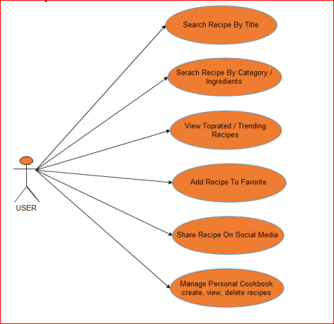

Slide 15
Scope of the Project
This project allows the users to find recipes based on different criteria such as, course, cuisine, and type of food. It also provides a filtering system that can be used to filter the list of recipes based on the ingredients used in each recipe, the time it takes to make the food. The app also allows the users to add their own recipes using the interface provided. A feature that I would like to implement is some sort of moderation system for recipe addition. A set of guidelines will then be shown to users to help them add their recipes to the database. Another feature that I would like to implement in the app is a user system.

Slide 16
This system would allow the users to create an account using an email address. This would then allow the recipes to be added only by the register users, instead of anyone using the app. This would make the moderation of the app users much easier, This system would also allow the users to update the recipes that they have already added to the database. This application is extremely handy and useful for cooking variety of recipe with minimum search efforts from internet. Internet recipe may appeal to one but not to other, some people like experimenting and trying own recipe. This app also provides ability to user to create recipe and save it for later reference.

Slide 17
It will help people to save their time and energy in finding recipes for daily routine as well as for special occasions. It can be use by broad range of users which may include parents trying to cook new recipe for kids, people who are fond of desserts, restaurants owner trying to add new items to their menu and for regular cooking. It will help to make the lives of people simpler. In the end, the final goal of this mobile application is to provide a platform that allows anyone to share and find food recipes conveniently.

Slide 18
References
Merriam-Webster. Database | Definition of Database by Merriam-Webster. Retrieved May 4, 2018 from https://www.merriamwebster.com/dictionary/database.
Firebase. Firebase Products. Retrieved May 4, 2018 from https://firebase.google.com/products/.
Katherine Chou, Xavier Ducrohet, Tor Norbye. 2013. Android Developers Blog:
Android Studio: An IDE built for Android. Retrieved May 5, 2018 from https://androiddevelopers.googleblog.com/2013/05/android-studio-ide-built-for-android.html.
Android Developers. Android Studio Features | Android Developers. Retrieved May5, 2018 from https://developer.android.com/studio/features/

Slide 19
Thank You

